Slide 1
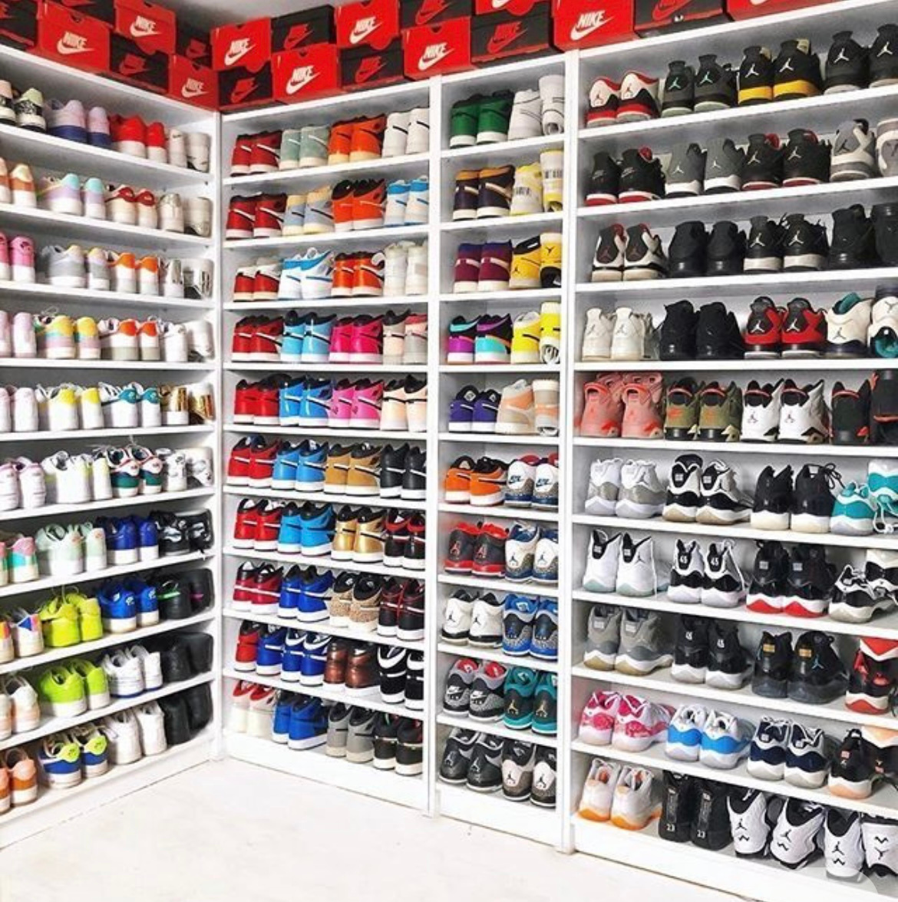
PREDICTING SNEAKER
RESALE VALUE :
A MULTI-MODEL MACHINE LEARNING APPROACH
SHAILANSHI GUPTA
INTRODUCTION TO Business Analytics Project
December 2024

Slide 2

THE BUSINESS PROBLEM
THE SNEAKER RESALE MARKET
- Multi-billion dollar industry with 200-400% markups
- Our data: Average sneaker sells for $447 (213% of $209 retail)
The Challenge
- Which sneakers will hold/gain value?
- Buyers and resellers need data-driven guidance
Research Question
- Can we predict sneaker resale prices?
- What factors drive value?

Slide 3

WHO BENEFITS FROM THIS ANALYSIS?
👤 CONSUMERS
Make smarter
purchasing decisions
Identify investment-
worthy sneakers
💼 RESELLERS
Optimize inventory
selection
Maximize profit
margins
🏢 BRANDS
Understand market
drivers
Inform pricing
strategies

Slide 4

DATA SOURCE AND OVERVIEW
99,956
TOTAL
TRANSACTIONS
DATA SOURCE
- StockX marketplace (real resale platform)
- 99,956 sneaker sales transactions
- Time period: 2017-2019
ORIGINAL VARIABLES (8)
- Sale Price & Retail Price
- Brand & Sneaker Name
- Order Date & Release Date
- Shoe Size & Buyer Region
$ 209
AVERAGE RETAIL
PRICE
$ 447
AVERAGE
RESALE PRICE
213 %
AVERAGE
MARKUP

Slide 5

FEATURE ENGINEERING:
CREATING PREDICTIVE VARIABLES
DATA CLEANING
- Removed $ signs and commas from prices
- Converted text dates to date format
- Handled missing values
- Result: Clean dataset ready for modeling
FROM 8 TO 17 VARIABLES
-Original: 8 variables
-Created: 9 new engineered features
-Total: 17 variables for modeling
NEW FEATURES CREATED
⏰ TIME-BASED
- Days Since Release (sneaker age)
- Release Year, Sale Year, Sale Month
💰 PRICE-BASED
- Markup in Dollars (profit)
- Log transformations (for regression)
🏷️ CATEGORICAL
- Is Premium Brand? (Yeezy/Off-White/Jordan)
- Price Category (Budget/Mid/Premium)
- Above Retail? (Yes/No)
RAW DATA
CLEANING
FEATURE
ENGINEERING
READY FOR
MODELING

Slide 6
METHODOLOGY: MULTI-MODEL APPROACH
WHY MULTIPLE MODELS?
- Compare different statistical techniques
- Identify best approach for price prediction
- Validate findings across methods
MODEL 1: LINEAR REGRESSION - SIMPLE
→ Baseline with 3 predictors: Retail Price, Brand, Age
MODEL 2: Linear Regression - Full
→ Added variables: Premium status, Month, Year, Region
MODEL 3: Log-Transformed Regression
→ Log transformation of prices for better fit
MODEL 4: Generalized Linear Model (GLM)
→ Flexible regression approach (gaussian family)
MODEL 5: Decision Tree
→ Non-linear, rule-based predictions

Slide 7
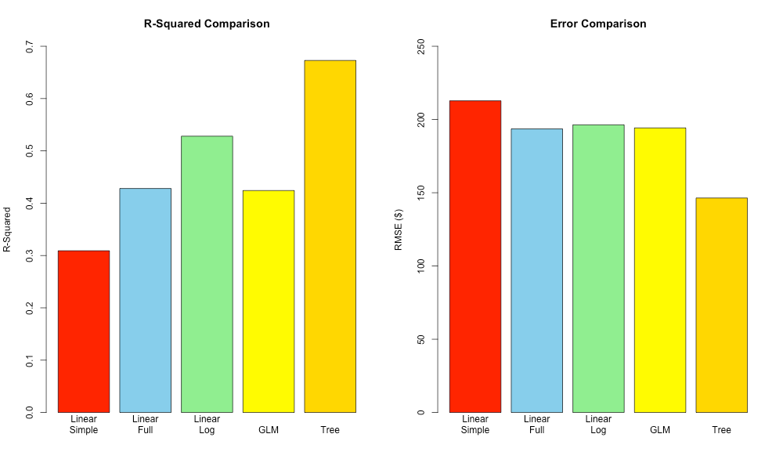
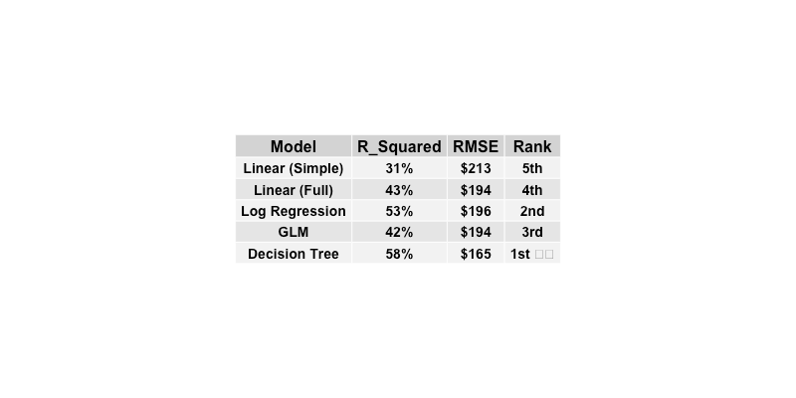
RESULTS: MODEL PERFORMANCE COMPARISON
KEY FINDINGS
✓ Decision Tree achieved highest
accuracy (58% R²)
✓ All models improved from
simple to complex
✓ Tree-based approach captured
non-linear patterns
✓ Lowest prediction error: $165
(Decision Tree)

Slide 8
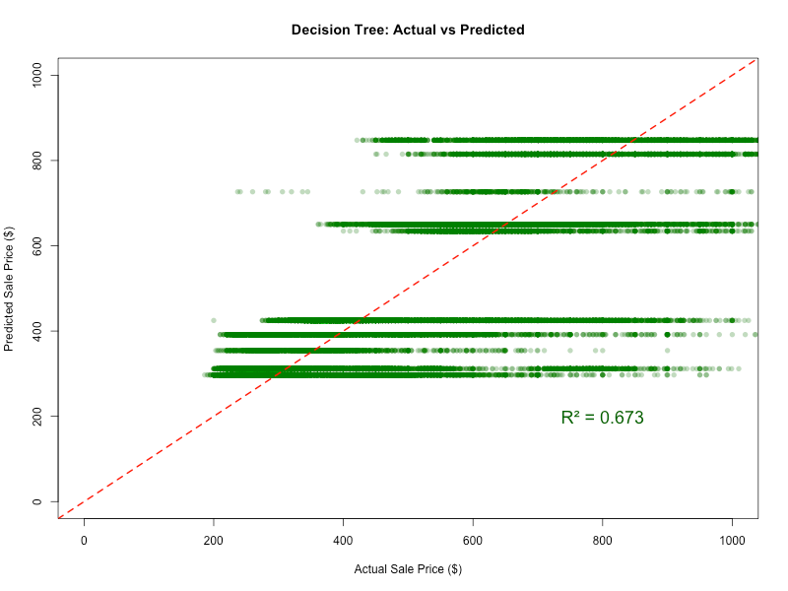
BEST MODEL: DECISION TREE (58% R²)
[ 58% ]
[ $165 ]
[ #1 ]
R^2
ERROR
RANK
WHY DECISION TREE WON
✓ Captured non-linear
relationships
✓ Better handling of brand
interactions
✓ Most flexible pattern
recognition
✓ Lowest prediction error ($165
vs $213 baseline)
MODEL USES
- Retail Price, Brand, Days Since
Release
- Sale Month, Release Year
- Makes sequential rule-based
decisions

Slide 9
KEY INSIGHTS: WHAT DRIVES SNEAKER RESALE VALUE?
1️⃣ RETAIL PRICE 💰 - STRONGEST PREDICTOR
- Higher retail = Higher resale (4x multiplier effect)
- Premium positioning pays off
- Price signals quality and exclusivity
2️⃣ BRAND PREMIUM 👑 - Massive Impact
- Yeezy, Off-White, Jordan: 200-400% markups
- Nike/Adidas standard models: 50-100% markups
- Brand reputation = major value driver
- Collaborations command highest premiums
3️⃣ TIME EFFECTS ⏰ - Double-Edged Sword
- Newer releases: Lower immediate resale (high supply)
- Older releases: Higher value (scarcity effect)
- Sweet spot: 6-12 months after release
- Vintage factor increases with time
🎯 SURPRISING FINDING
Mid-range sneakers ($150-$220) perform BEST
→ Perfect balance: accessible yet premium
→ Highest ROI for resellers

Slide 10
BUSINESS IMPLICATIONS & RECOMMENDATIONS
👤 FOR CONSUMERS
Smart Buying Strategy
- Focus on limited releases from premium brands
- Target mid-range retail prices ($150-$220)
- Buy within first 6 months for best resale potential
- Decision Tree model = 58% prediction accuracy
💼 FOR RESELLERS
Inventory Optimization
- Prioritize: Yeezy, Off-White, Jordan collaborations
- Sweet spot retail: $150-$220 range
- Hold inventory 6-12 months for optimal returns
- Predict resale value BEFORE purchasing
🏢 FOR BRANDS
Strategic Insights
- Limited releases drive secondary market value
- Premium positioning justified by resale data
- Collaborations highly effective for brand value
- Use model to inform pricing strategies
DATA-DRIVEN DECISIONS IN
THE SNEAKER RESALE MARKET
- 58% Prediction Accuracy
- $165 Average Error
- 5 Models Tested
📊 PRACTICAL TOOL
THIS MODEL CAN BE DEPLOYED AS:
→ REAL-TIME PRICING PREDICTION TOOL
→ INVESTMENT DECISION SUPPORT SYSTEM
→ MARKET ANALYTICS DASHBOARD
INPUT: NEW RELEASE DETAILS
OUTPUT: PREDICTED RESALE VALUE + CONFIDENCE INTERVAL

Slide 11
THANK YOU !!

